Slide 1

A PRISMA Review on the Paradigm Shift in Neuroentrepreneurship Education across Asian Developing Countries: Visualization and Analysis
A. Mithursan & N.T.K.P. Fernando

Slide 2
Concept Clarification
Cognitive Science:
Behavioral Science
Cognitive Neuroscience
Entrepreneurship studies
Electroencephalogram (EEG)
Functional Magnetic Resonance Imaging (FMRI)
Eye tracking
Galvanic Skin Response

Slide 3

Introduction
Neuroentrepreneurship
Entrepreneurial Study
Cognitive Science
Behavioral Science
Heuristic Ideas
Entrepreneurial Mindset
Cognitive Process of Decision Making
Dynamism
Leadership
Risk Taking Capacity
Adaptability
Internal Drive
An individual with an entrepreneurial mindset can produce value by identifying and seizing opportunities, making decisions with incomplete information, and maintaining flexibility and resilience in sometimes complex and difficult circumstances.
How decisions are made about the competence and conduct of the entrepreneur.
(Joshua et al.,2021).

Slide 4
Introduction
Neuroentrepreneurship
Cognitive Neuroscience
Electroencephalogram (EEG)
Functional Magnetic Resonance Imaging (FMRI)
Eye tracking
Entrepreneurship studies
Cognitive Science
Behavioral Analysis
Neuroentrepreneurship
Galvanic Skin Response
(Joshua et al.,2021) & Korpysa (2020)

Slide 5
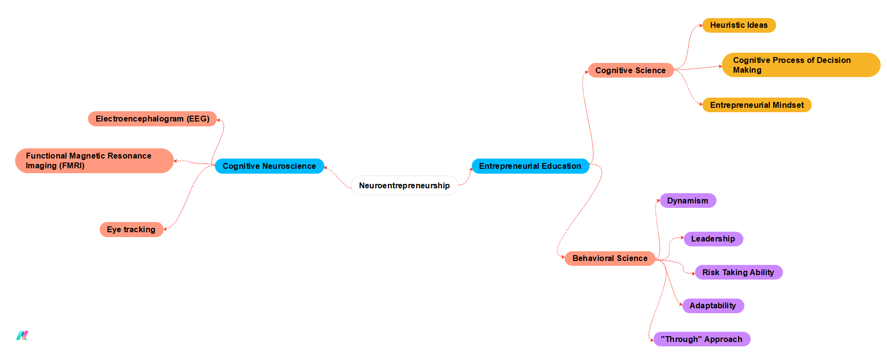
Theorizing the concept of neuroentreprenership

Slide 6
Research Problem
“through” approach to entrepreneurial education”

Slide 7
Research Objective
Study
To investigate the potential of neuroentrepreneurial education and training in fostering a nascent undergraduate entrepreneurial mindset in developing countries considering the increasing unemployment rate during this crisis.
Systematic Review
To explore the emerging field of neuroentrepreneurship and its potential to shift the understanding of how entrepreneurs think, act, and make decisions.
At the End
Systematically identify, analyze, and synthesize the existing research on neuroentrepreneurship focusing on key neural correlates of entrepreneurial behavior, decision-making, and risk-taking.

Slide 8
Objective (Cont.)
Variables Affect to Entrepreneurial Mindset
Mind Set of Nascent Entrepreneur
Through the Systematic Revie on Neuroentrepreneurship

Slide 9
Literature Review
Heterodox Perspective on Entrepreneurship
Entrepreneurship and region are significant academic topics with cultural implications globally (Smith et al., 2019).
Pew Research Centre (2015) highlights that 80% of the world's population practices various religions, influencing beliefs and traditions.
Smith et al. (2019) emphasize the profound impact of social systems on entrepreneurship worldwide.
Religion is viewed as both an embarrassing incident and a commercial aspiration with holy responsibilities (Longman, 2008).
Sigalow (2016) suggests integrating personal beliefs and moral values into entrepreneurship, combining religion and business.
Pidduck and Tucker (2022) propose mindful heterodoxy through religious beliefs, creating complexity in the intersection of religion and business.

Slide 10
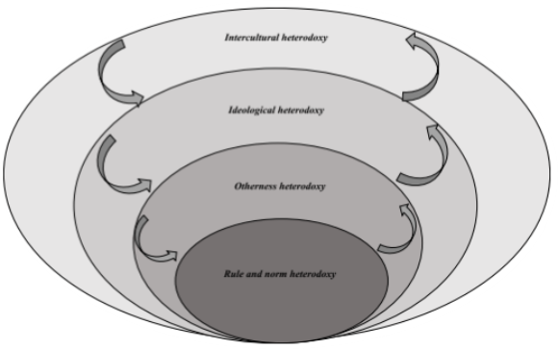
Literature Review
Heterodox Perspective on Entrepreneurship
R&E multiple compounding approach reveals aspects of intercultural heterodoxy (Pidduck and Tucker, 2022).
Cultural barriers and conflicts arise from movement in religious and cultural boundaries (Pidduck and Tucker, 2022).
Ideological heterodoxy involves conflicts based on deeply entrenched beliefs, challenging established understandings (Smith et al., 2019).
Otherness heterodoxy explores opinions deviating from expectations, addressing skepticism and foreignness (Pidduck and Tucker, 2022).
Figure 02 illustrates cascading contexts for meaningful heterodoxies.
Effective communication strategies are crucial for entrepreneurs to navigate social identity, legitimacy, and inclusion/exclusion (Fisher et al., 2017).
Source: Pidduck and Tucker (2022)

Slide 11
Literature Review
Neuroscience and its Advancement with Entrepreneurial Cognition
Shane, Locke, and Collins (2003) emphasize the hidden advantage of new opportunities through the cognitive application of transforming ideas into business ventures.
The establishment of new enterprises involves a deep cognitive process, commencing with a brainstorming session to identify the potential business and its resources (Baron, 2007).
Creativity is a pivotal characteristic in entrepreneurship, where entrepreneurs utilize cognitive structures to gather information and convert ideas into profitable businesses (Baron, 2006).
Cognitive science, as described by Baron (2006), is a study of pattern recognition that explores meaningful occurrences or changes.
Baron & Ensley's (2006) findings highlight the role of a strong cognitive framework in identifying novel patterns and business opportunities, demonstrating the link between cognitive processes and entrepreneurial mindset dedication

Slide 12
Literature Review
Paradigm Shift of Neuro entrepreneurship
Foundation in Cognitive Philosophy:
Santos et al. (2016) emphasize the significance of neuro-entrepreneurship research.
Neuroentrepreneurship is characterized by mirror neurons, empathy, reproduction semantics, dopamine system, and social behaviors.
Entrepreneurial Learning Impact:
Studies reveal a direct influence on the mindsets of aspiring entrepreneurs.
Undergraduate students, through creative thinking based on positive emotions, identify opportunities and translate ideas into business execution (Liu et al., 2022).

Slide 13
Literature Review
Paradigm Shift of Neuro entrepreneurship
Area | Description
Foundation in Cognitive Philosophy | Santos et al. (2016) emphasize the significance of neuro-entrepreneurship research.
 | Neuroentrepreneurship is characterized by mirror neurons, empathy, reproduction semantics, dopamine system, and social behaviors.
Entrepreneurial Learning Impact | Studies reveal a direct influence on the mindsets of aspiring entrepreneurs.
 | Undergraduate students, through creative thinking based on positive emotions, identify opportunities and translate ideas into business execution (Liu et al., 2022).

Slide 14
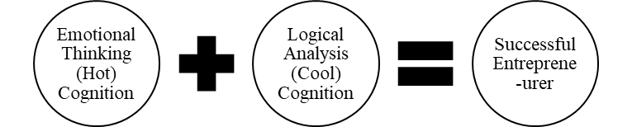
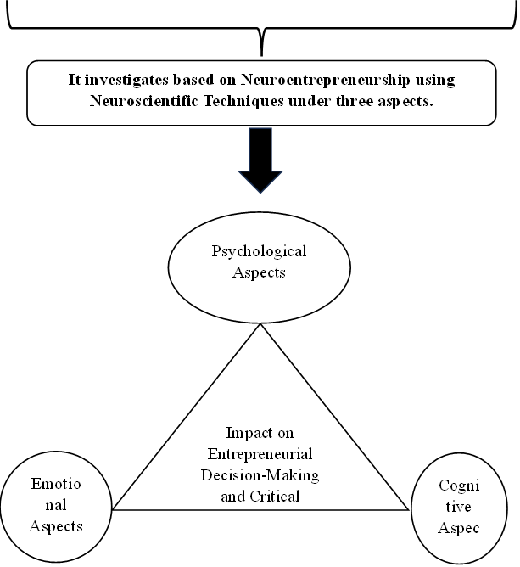
Literature Review
Theorization of Paradigm Shift of Neuro entrepreneurship

Slide 15
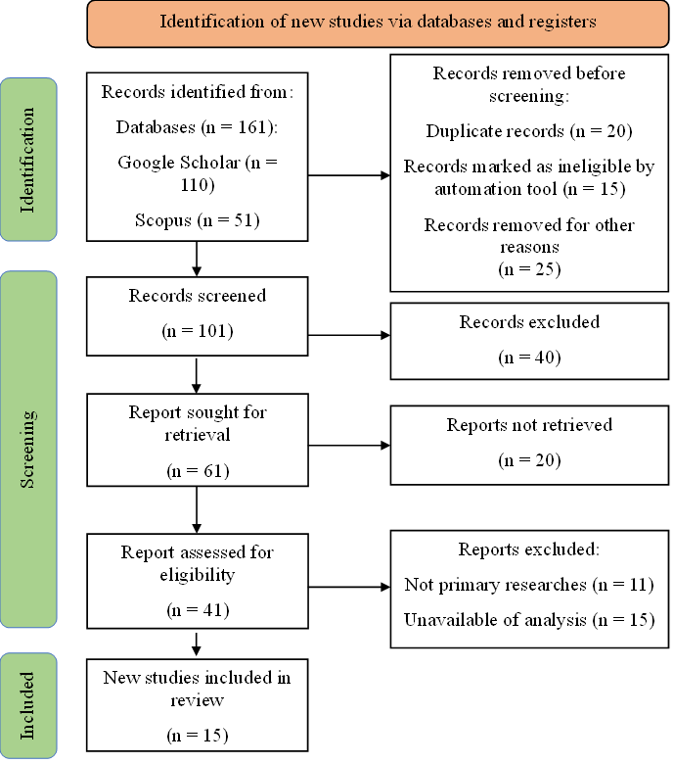
Methodology
The methodology consists of a systematic review PRISMA (Preferred Reporting Items for Systematic Reviews and Meta-Analyses) framework employed in this review.
Source: Authors

Slide 16
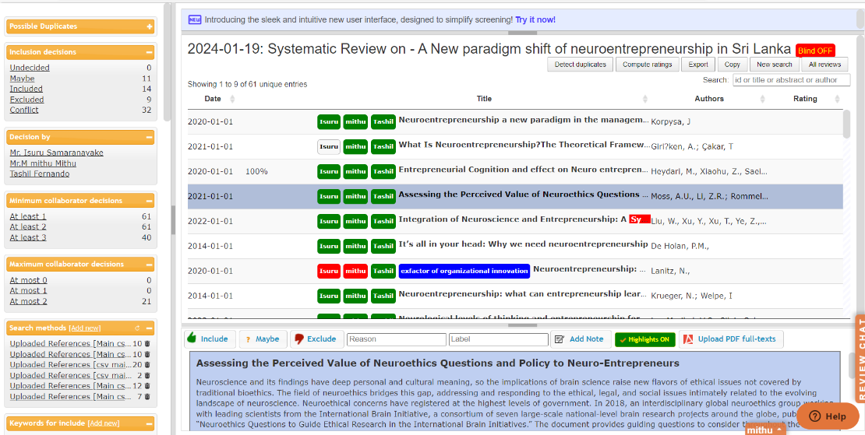
Methodology
Articles were selected according to the PRISMA framework with the application of the Ryyan Systematic Review tool.
Source: Authors

Slide 17
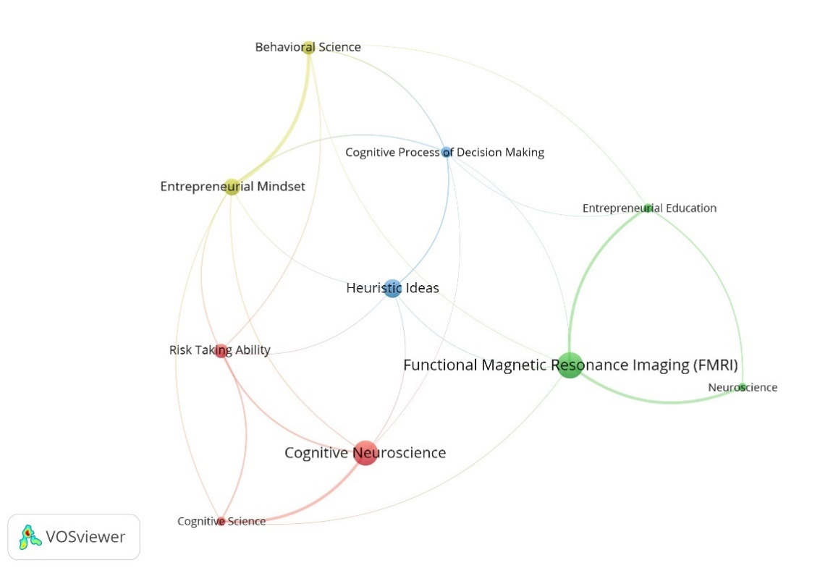
Methodology
Neuroentrepreneurship Education Clusters
Visualization and Conceptualization of neuroentrepreneurship evolution for the first time through a critical analyzes of key articles
Interdisciplinary Aspects In The Entrepreneurial Education
This VOSviewer network map explain the two main clusters of neuroentrepreneurship education such as cognitive neuroscience and entrepreneurship education. Under the two main clusters hold the main factors influencing the connection between respective variables with the main clusters.
Source: Authors

Slide 18
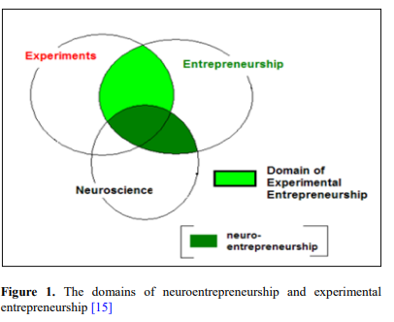
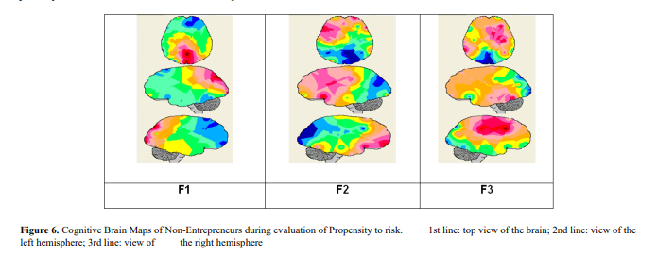
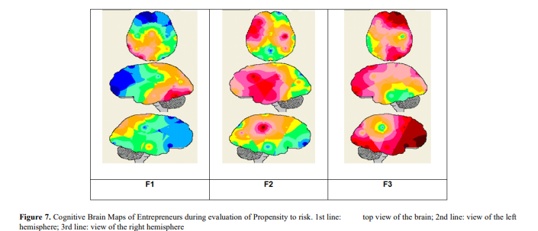
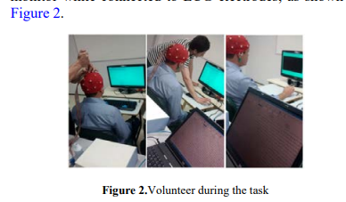
PRISMA Retrieval
Cognitive Brain Mapping (CBM) with EEG Reading (Zaro et al., 2016 )
Neuroentrepreneurship

Slide 19
Entrepreneurial Behavior
When deciding about loan options for investment in the jewelry market, the volunteers Non-Entrepreneurs showed a stronger frontal neural circuit in the right hemisphere (F1), a bilateral posterior circuit (F2) and another more medial posterior circuit (F3), as shown on Figure 6.
Volunteer Entrepreneurs used a bilateral frontal circuit (F1) and another circuit involving only a specific front area of the right hemisphere and another medial specific area in the parietal region (F2) while the last factor (F3) does not show any clear neural circuitry, as can be seen on Figure 7

Slide 20
PRISMA Retrieval
Cognitive Brain Mapping (CBM) with EEG Reading
Neuroentrepreneurship
Source: (Zaro et al., 2016 )

Slide 21
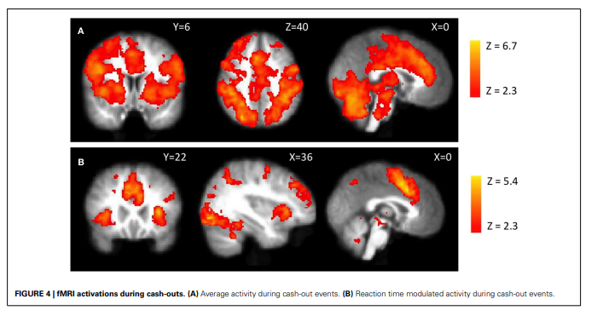
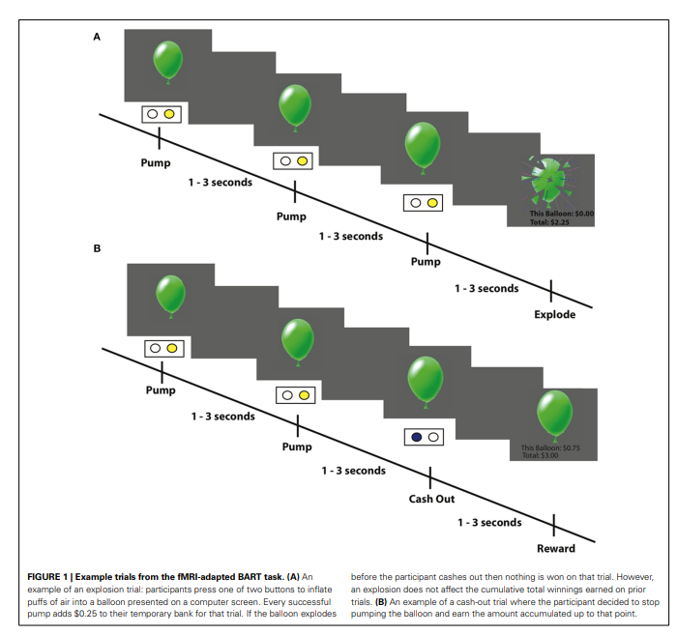
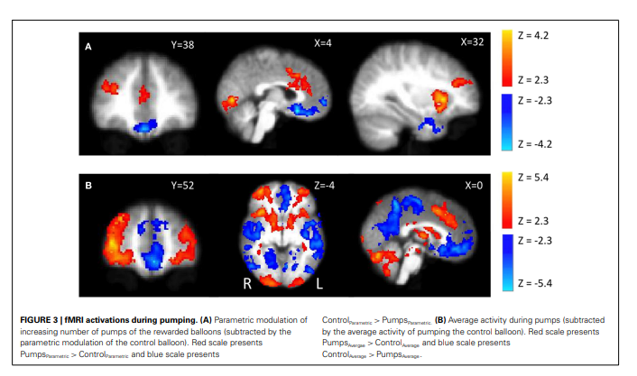
FMRI Investigation of the Balloon Analog Risk Task (BART)
Source: Schonberg et al., 2012

Slide 22
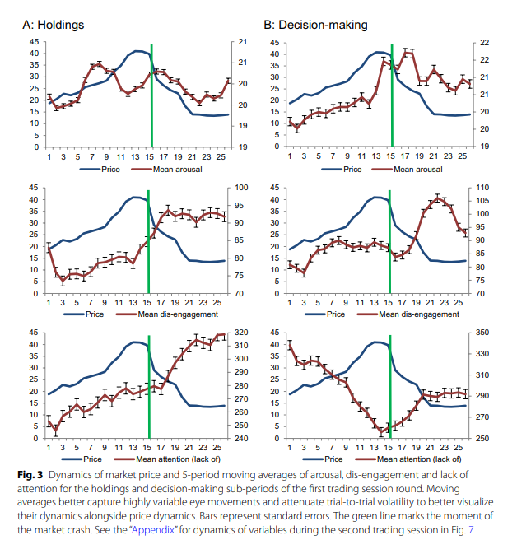
Effects of price dynamics on eye movements
Trading behavior Vs Eye movement
Trading Session Dynamics:
Arousal quickly rises, subsides before market peak, and spikes during crashes.
Disengagement and lack of attention steadily increase with the market, peaking post-crash.
Decision-Making Sub-Period:
Arousal and disengagement spike similarly during decision-making.
Attention increases with market growth.
Subjects focus more on the center when making trading decisions.
Source: Schonberg et al., 2012

Slide 23
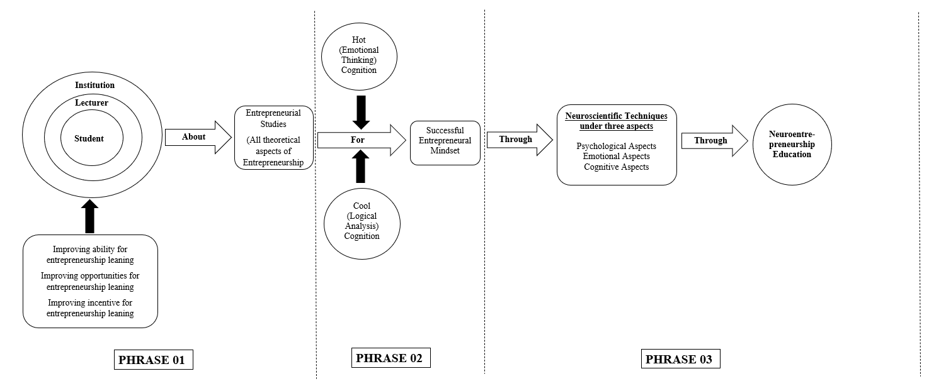
Conclusion
Source: Authors

